Slide 1
F&I
Agile Development and Delivery Approach
Last Updated: Tuesday, March 26, 2019

Slide 2
Change Development Approach from Phasing to IID
From: Phasing Approach
Requirements
Analyst & Design
Coding
Testing
Accepted
Big Bang
Release
E
F
E
F
E
F
E
F
E
F
E
F
D
D
D
D
D
D
C
C
C
C
C
C
A
B
A
B
A
B
A
B
A
B
A
B
Time
To: Iterative and Incremental Development Approach IID): Agile for Software Development
Requirements
Iteration 1
Iteration 2
Iteration 3
Iteration 4
1. Each story is expanded, coded and tested
E
F
E
F
2. Possible release after of each iteration
(small release)
D
D
D
C
C
C
C
A
B
A
B
A
B
A
B
A
B

Slide 3
Agile is a term to describe methods that:
Have fast feedback cycles
Requires active participation from the business
Deliver business value at regular intervals
Demands whole team collaboration
Test features as they are coded
Based on sustainable pace
Adapt their processes based on feedback
Notes:
A bit of the history – of agile testing. Testing features / stories are more than customer tests / developer tests
Note: Product Owners represent the customer / business

Slide 4
Basic Agile Building Blocks
Incremental changes
Common values - trust
Continuous integration
Discipline
Verbal communication
Automation
Retrospectives
Notes:
I'm seeing a lot of teams keep over-committing, they can never get traction if they don't start under-committing until they get the skills and get into a test-code-test and building rhythm

Slide 5
So, What is Agile?
A set of principles rather than a particular model
An umbrella to describe methodologies that follow the Agile Manifesto principles
Scrum Framework (be used in this project for a project management framework)
XP: Extreme Programming (be adopted in this project for software engineering practices)
Kanban
DSDM: Dynamic Systems Development Method
Crystal
Feature Driven Development (FDD)‏

Slide 6
Development and Delivery Approach
Release
Pre-Game
Game (Iterations / Sprints)
Post-Game
Initiated Project Backlog
Iteration X Length 10 Days
Goal
End Game
Following
the activities of current process to deploy tested software to
Production servers
Day 1
Day 2 – Day 9
Day 10
AM
Define Automation Test Strategy
Final User Acceptance Testing
Daily Sync Up
Final Regression Testing
Initiated
Release Planning
Final System Testing
End to End Tests
Number of Iterations
Approved High Level Architecture
X
Load/Performance Tests
Iteration Plan
Development
Iteration Review
Data Conversion
Iteration Retrospective
Install Tests
PM
Stories Readiness Workshops
Release Readiness
Release Retrospective
Prepare to Develop
Project Management – Monitor and Management
Iteration is timebox that be used in Extreme Programming (XP)
Sprint is timebox that be used in Scrum Framework
Last updated: March 26, 2019
Notes:
I'm seeing a lot of teams keep over-committing, they can never get traction if they don't start under-committing until they get the skills and get into a test-code-test and building rhythm

Slide 7
Pre-Game: Release Planning
Define the Schedule
Understand the business problem
Understand the technical challenges
Ensure resources for testing will be available
Plan customer involvement
Plan ahead for release activities
Packaging, delivery
Training, documentation, 3rd party interaction
Plan for communication, course corrections
Consider dependencies
Notes:
I'm seeing a lot of teams keep over-committing, they can never get traction if they don't start under-committing until they get the skills and get into a test-code-test and building rhythm

Slide 8
Pre-Game: Release Planning
Status and Visibility
Tracking testing tasks, progress
Stories, tasks, defects
Tracking & communicating
Build results
Test results
Metrics
Notes:
I'm seeing a lot of teams keep over-committing, they can never get traction if they don't start under-committing until they get the skills and get into a test-code-test and building rhythm

Slide 9
Basic Agile Building Blocks
Expertise and Solutions
Identify expertise not on the team
Bring specialist in
Budget time to develop expertise
Spike technical solutions
May need stories to research
Technologies
Architecture
Notes:
I'm seeing a lot of teams keep over-committing, they can never get traction if they don't start under-committing until they get the skills and get into a test-code-test and building rhythm

Slide 10
Release Planning
Product Backlog
Release Planning Meeting
Release Plan
4 May
27 Jul
Pre-Game
Game (Iterations / Sprints)
Post-Game
Iteration 1
Iteration 2
Iteration 3
Iteration 4
End Game
6 May – 25 May
27 May – 15 Jun
17 Jun – 6 Jul
8 Jul – 27 Jul
22 Jul – 27 Jul
6 May – 17 May
20 May – 31 May
3 Jun – 14 Jun
17 Jun – 28 Jun
1 Jul – 12 Jul
15 Jul – 26 Jul
22 Jul – 26 Jul
…
Last updated: March 26, 2019
Notes:
I'm seeing a lot of teams keep over-committing, they can never get traction if they don't start under-committing until they get the skills and get into a test-code-test and building rhythm

Slide 11
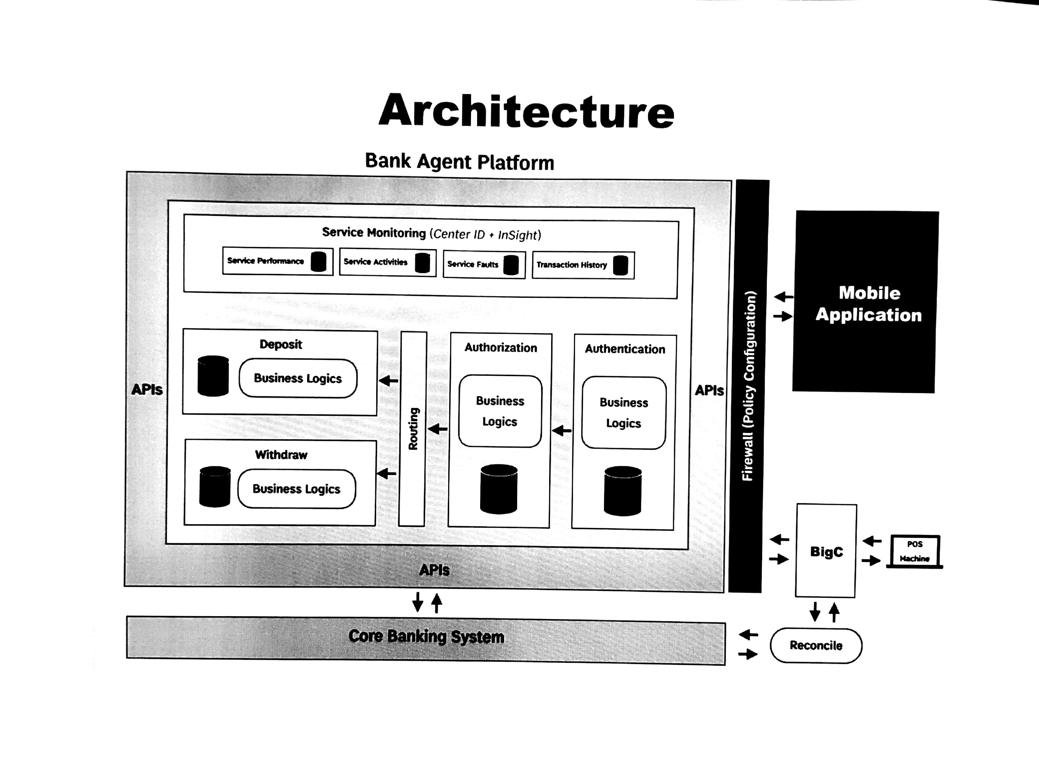

Slide 12
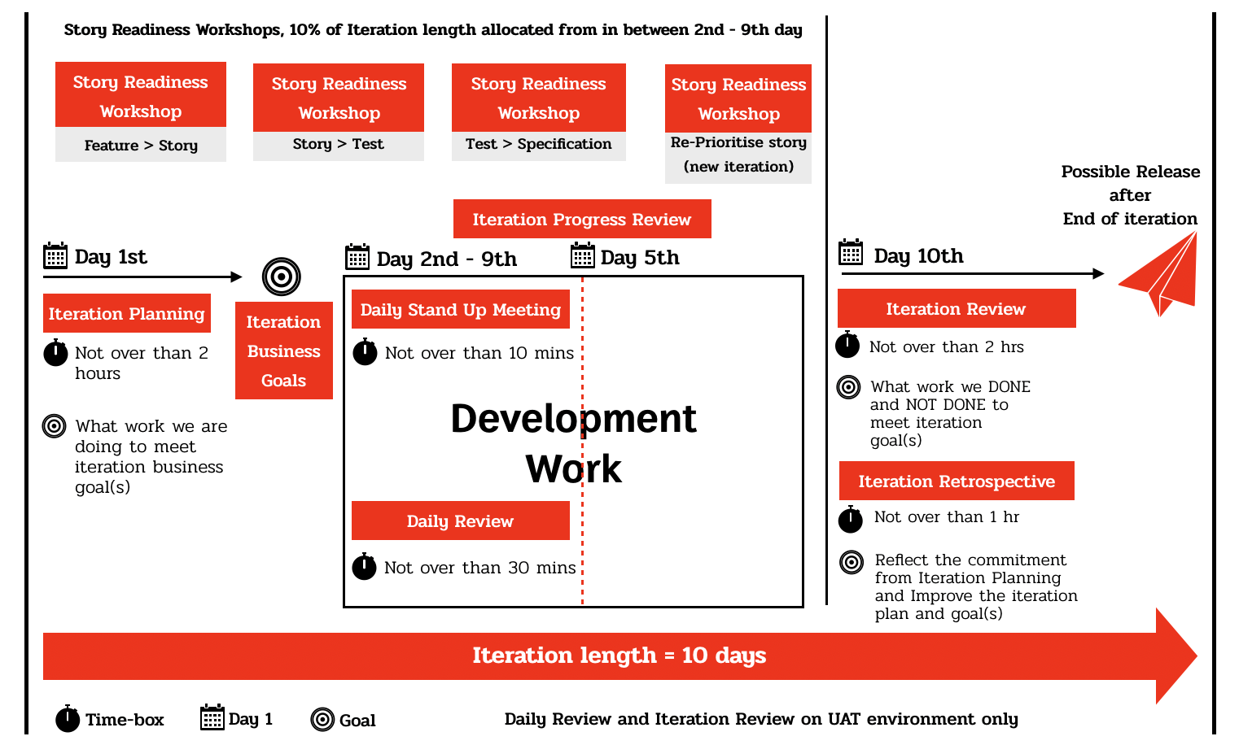
Iteration Framework
Last updated: March 26, 2019
Notes:
I'm seeing a lot of teams keep over-committing, they can never get traction if they don't start under-committing until they get the skills and get into a test-code-test and building rhythm

Slide 13
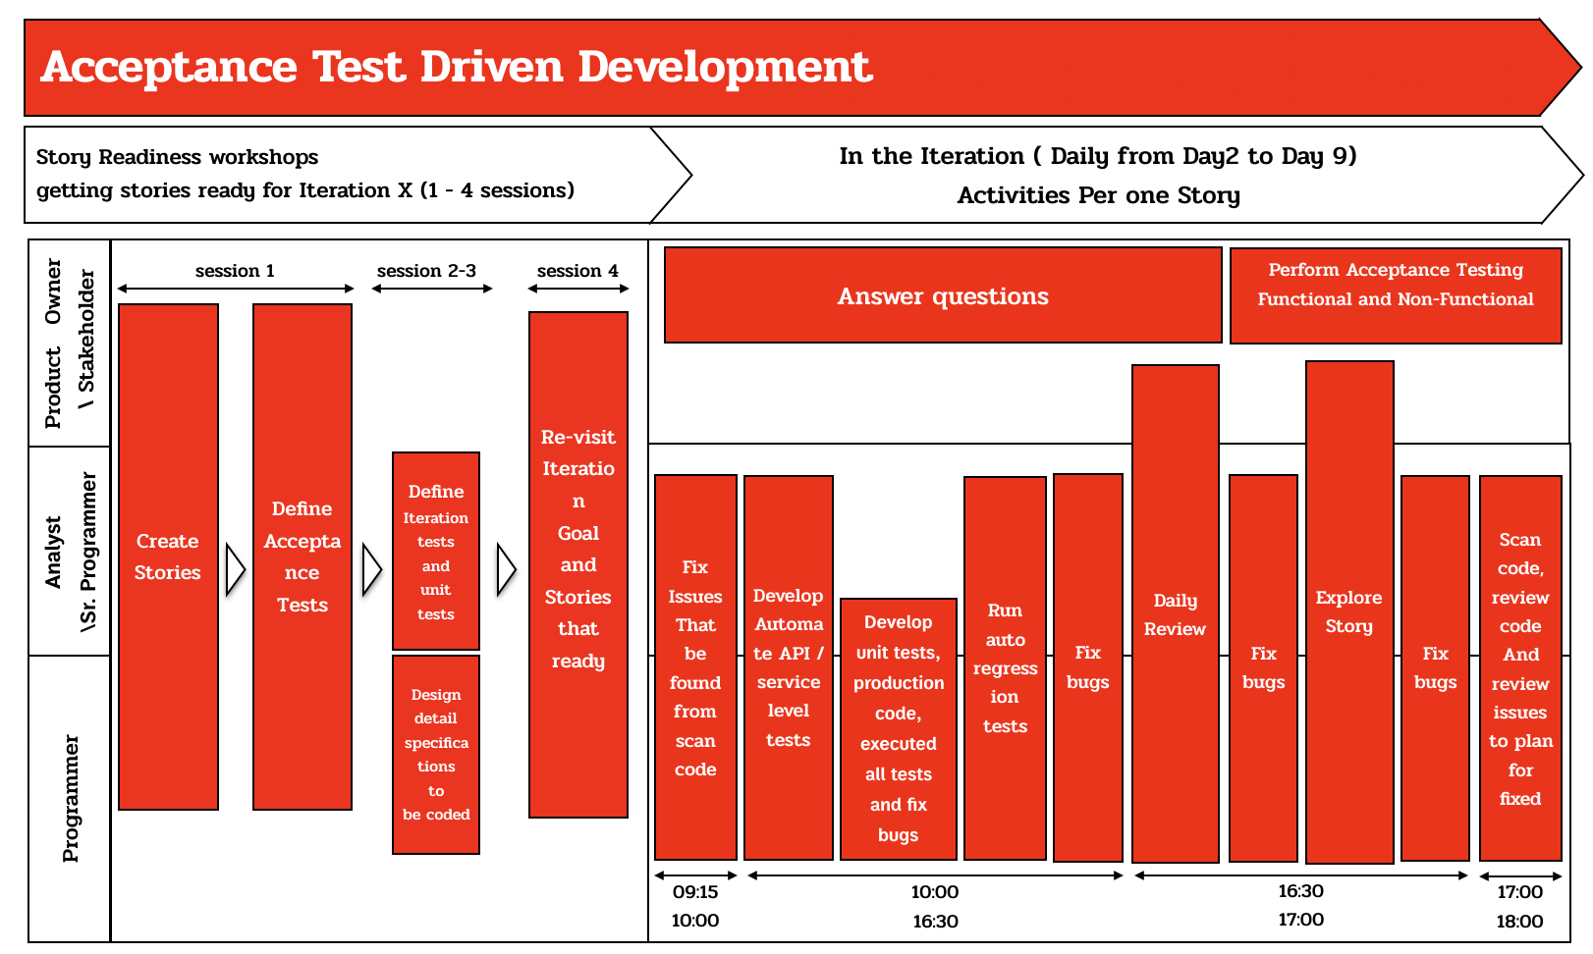
Acceptance Test Driven Development
Last updated: March 26, 2019
Notes:
I'm seeing a lot of teams keep over-committing, they can never get traction if they don't start under-committing until they get the skills and get into a test-code-test and building rhythm

Slide 14
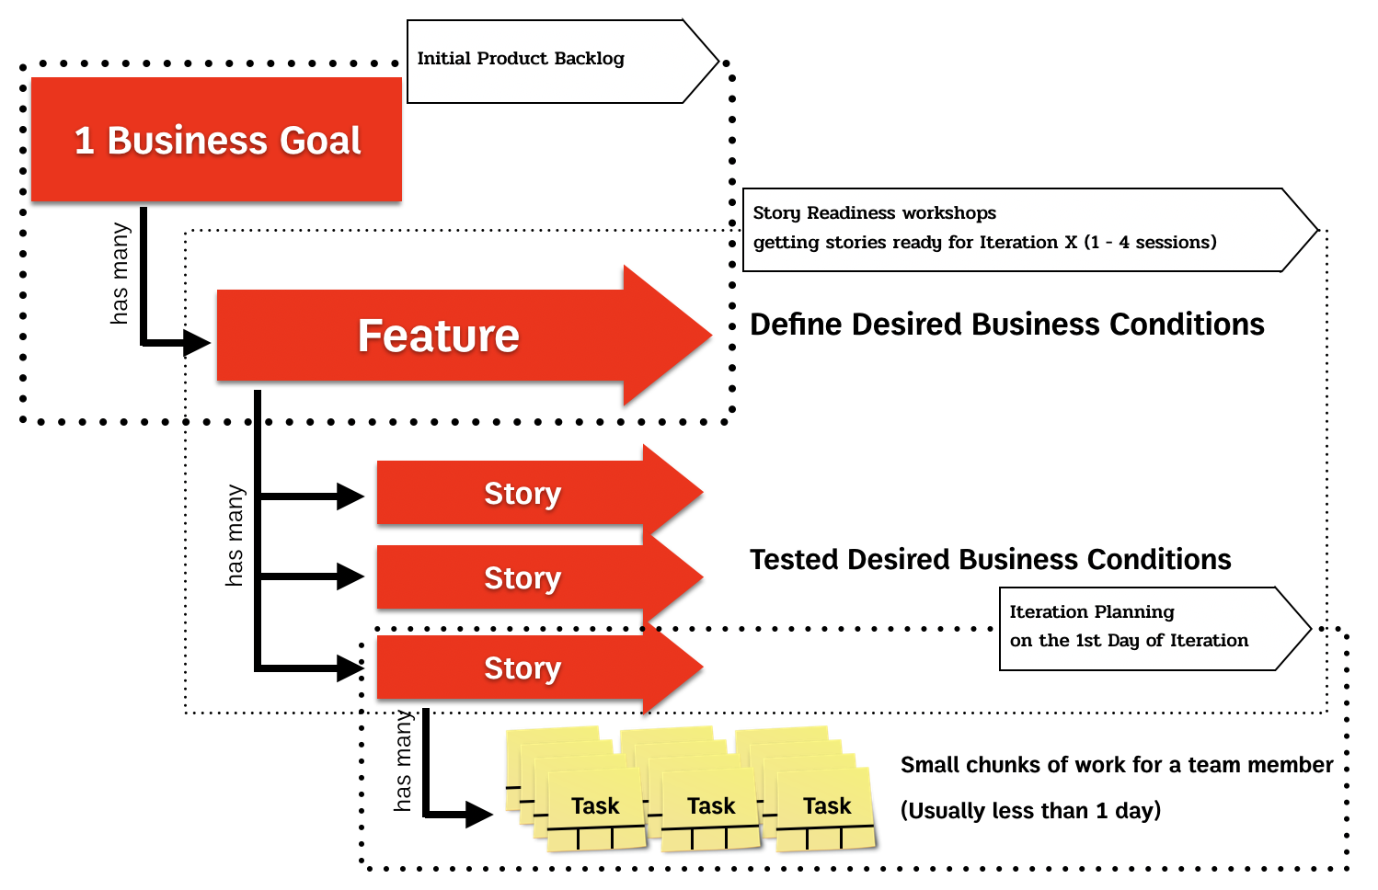
From Feature to Tasks
Last updated: March 26, 2019
Notes:
I'm seeing a lot of teams keep over-committing, they can never get traction if they don't start under-committing until they get the skills and get into a test-code-test and building rhythm

Slide 15
End of Documents

